Slide 1
Metro Vancouver Solid Waste Management Plan Independent Consultation and Engagement Panel
Dec 1, 2023

Slide 2
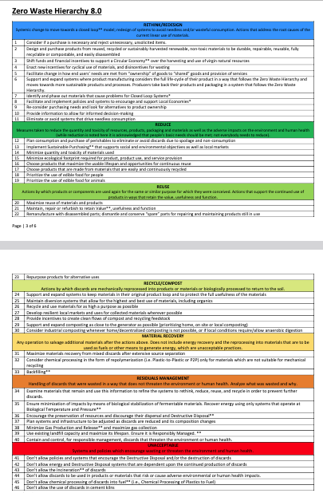
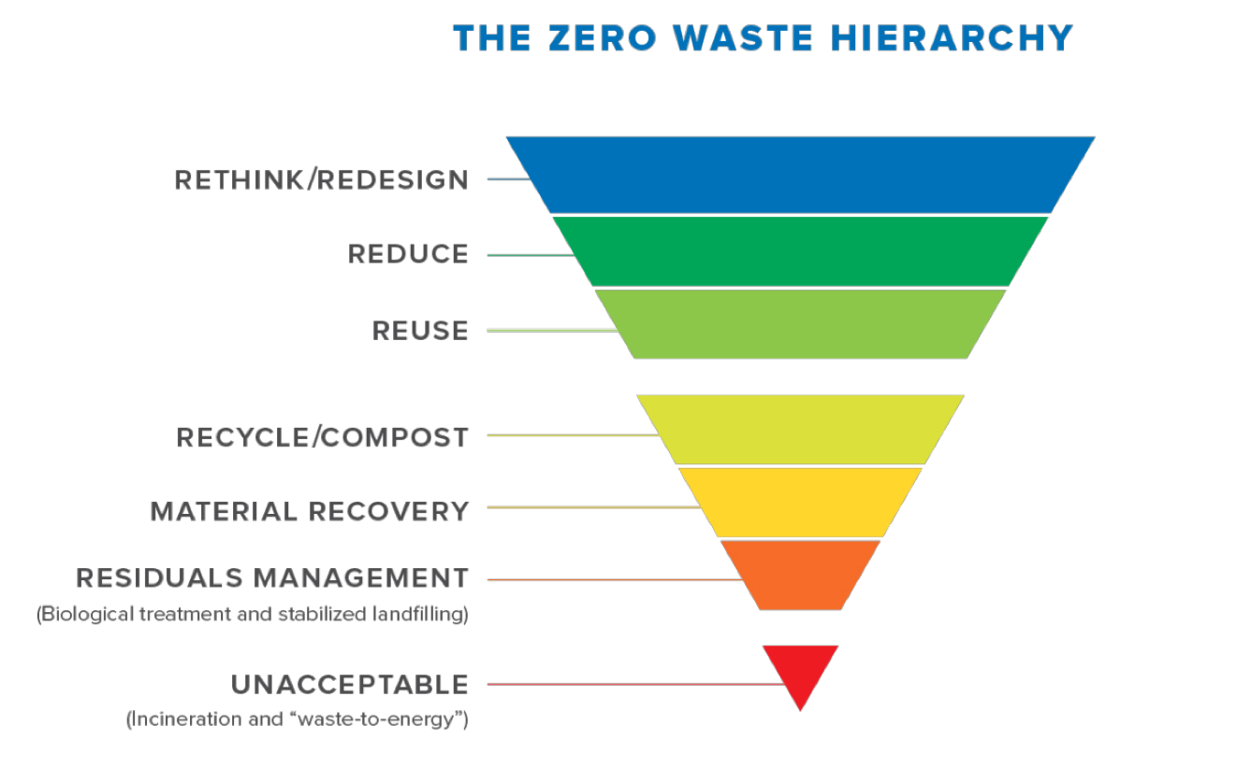
Zero Waste
The conservation of all resources by means of responsible production, consumption, reuse, and recovery of products, packaging, and materials without burning and with no discharges to land, water, or air that threaten the environment or human health.
2018, Zero Waste International Alliance

Slide 3
Outline
Review of data to learn for next plan
Waste amount
Waste disposal methods
Costs
GHGs
Energy
Risk
Recommendations
Notes:
Learn together because this is just what we can see from the outside.
Data is what we have gleaned from public information but note that it has been challenging as not all data was available for all of the years, way of tracking has changed, sometimes conflicting numbers

Slide 4
What is working
Generation per capita decreased by 112 kg/person since 2010, disposal decreased by 216 kg/person
That is almost 600,000 tonnes per year
More than twice the total amount going to the incinerator
ZW implementation cost effective and accomplished with a fraction of the budget
Total generation increased by 261,712 t or 8%
Notes:
Used 2010-2020 data as have the full suite, not yet for later years
20% goes to the incinerator, 80% landfilled

Slide 5
Costs
Costs | Incinerator | Landfills | Zero Waste -Not wasting
Operating Costs /t (2020) | $96.64 | $47.97 | $6.84
Operating costs total (2020) | $24M | $33M | $4M
Capital (2010-2027) | $244M | $58M | 0
Proportion of Waste | 1/5 | 4/5 | Negative
Tonnes | 244,362 | 987,163 | 597,896 avoided
Savings as waste not created |  |  | $54 M if incinerated $25 M if landfilled
Note: operating costs for landfill include capital costs, capital costs for LF are for maintaining closed Coquitlam site
Costs for WTE do not include the $2.5 M spent trying to pursue new WTE
Notes:
2020 numbers from budget + 2021 Biennial report
Uses average costs of program + public involvement, policy + facility dev, ZW, sustainability from 2010-2020 for not wasting, Used decrease in generation per capita times 2020 population
Included capital til 2027 from reports. Rising for WTE as need to replace it as old.
ZW includes budgets for all of policy and facility development, ZW implementation, Programs and public engage and sustainability fund averaged over the 11 years, waste avoided calculated using waste per capita from 2010 if BAU and using 2020 population
Operating costs of WTE net of revenue was $73.39 in 2020.

Slide 6
Capital costs driven by WTE
+ $92.9M since July
Notes:
Source July 13, 2023 ZWC agenda package, this is before the forecast capital requirements for the district energy and WTE components increased by another $92.9 M
Note Harrisburg PA bankrupt due to incinerator –important not to be destabilized by costs trying to maintain an old incinerator (35 yrs old)

Slide 7
Costs over time
Landfill operating costs up 4% (2010-20) (10% by 2027)
WTE operating costs up 22% (74% by 2027)
Increasing central costs in budget means less in solid waste budget for reduction work

Slide 8
Energy added
Energy needs to be added in the form of electricity and gas to make the incinerator work well. That amount of energy has increased by 54%.
It took over 144,000 GJ in 2020 -enough to power 2600 houses

Slide 9
Energy Out
Incinerator sold 544,558 GJ of energy (2020)
Vancouver Landfill sold 350,280 GJ (lower than in past)
Vancouver Landfill flared (did not sell) 920,123 GJ
This is more than the unsold steam energy from the incinerator (624,000 GJ in 2011 when Norampac last ran)
Notes:
2020 numbers –most recent comprehensive report by Metro Van 02021 Biennnial report
The energy flared but not sold from Metro Vancouver landfills is bigger than the net energy output of the Incinerator.

Slide 10
GHG Emissions by disposal
Declining from LF as decreasing organics and better landfill gas capture -75% less than 2010
Increasing for incinerator as requiring more input energy to run -101% more than 2010 and less efficient
GHGs - 2020 | Incinerator | Vancouver Landfill | External Landfill | Waste prevented
Non-biogenic GHG (tCO₂e/t waste) | 0.58 | 0.26 | 0.08 | negative
Including biogenic GHG (tCO₂e/t waste) | 1.28 | 0.32 | 0.14 | negative
Percentage of GHGs (total) | 64% | 36% | <1% | negative
Percentage of waste | 20% | 54% | 3% | -33%
Conclusion: To reduce GHGs, reduce the waste as much as possible but if it must be disposed, use existing landfill capacity.
Notes:
2020 numbers -2021 Biennial Report –Metro Vancouver
Note provincial reports show higher WTE emissions and lower VLF emissions

Slide 11
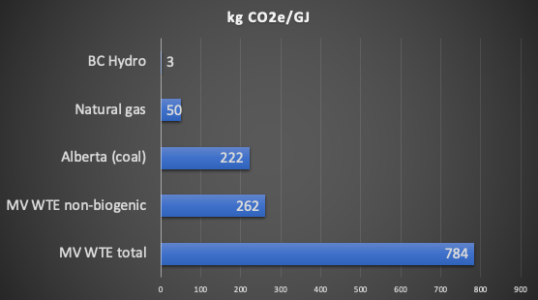
GHG Emissions by energy
the Burnaby Incinerator has been in the top 25 biggest GHG industrial point sources in BC for past 10 yrs
Notes:
Note for the past ten years the Burnaby Incinerator has been in the top 25 biggest GHG industrial point sources in BC (only pulp and paper mills, smelters, fossil fuel facilities and cement kilns were higher).
https://www2.gov.bc.ca/gov/content/environment/climate-change/data/industrial-facility-ghg
(only pulp and paper mills, smelter, fossil fuel facilities and cement kilns were higher)

Slide 12
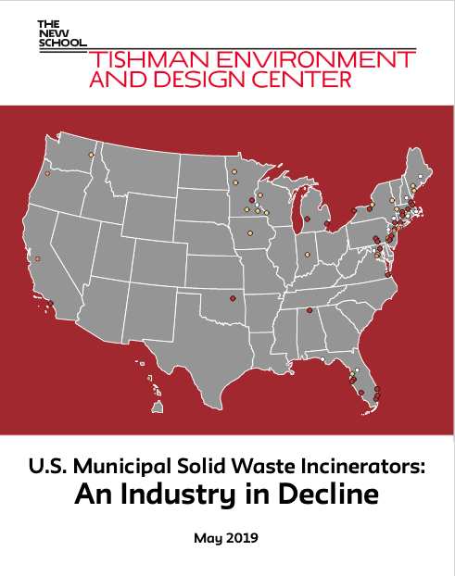
Time to retire
Study shows US incinerators closing
Costs to maintain, replacement parts
Keeping up with evolving health and environmental standards
Life expectancy 30 years, Burnaby WTE is 35 years old (1988)
OR continuous monitoring –dioxin/furans, SO₂,NO_{x}, toxic metals
Budget report (July 13, 2023)–predicting WTE operating costs to go up by 35% in 5 yrs + capital
Notes:
European studies have shown much higher dioxin emissions than reported
Waste Dive (Aug 4, 2023). Oregon becomes first state to require higher standard of continuous emissions monitoring at incinerators. https://www.wastedive.com/news/oregon-incinerator-emissions-law-sb-488-covanta-marion/689838/

Slide 13
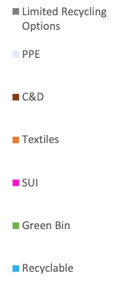
What is in the waste and does it have to be there?
Material | Energy (GJ/t)
Plastics | 36.8
Paper | 16.5
Organics | 8.9
Metals | 0.7
Glass | 0.2
Notes:
MV 2022 waste comp, MV energy
Note global, federal and provincial work on plastics, paper and organics
43% fossil fuel based and a very dirty kind of fossil fuel

Slide 14
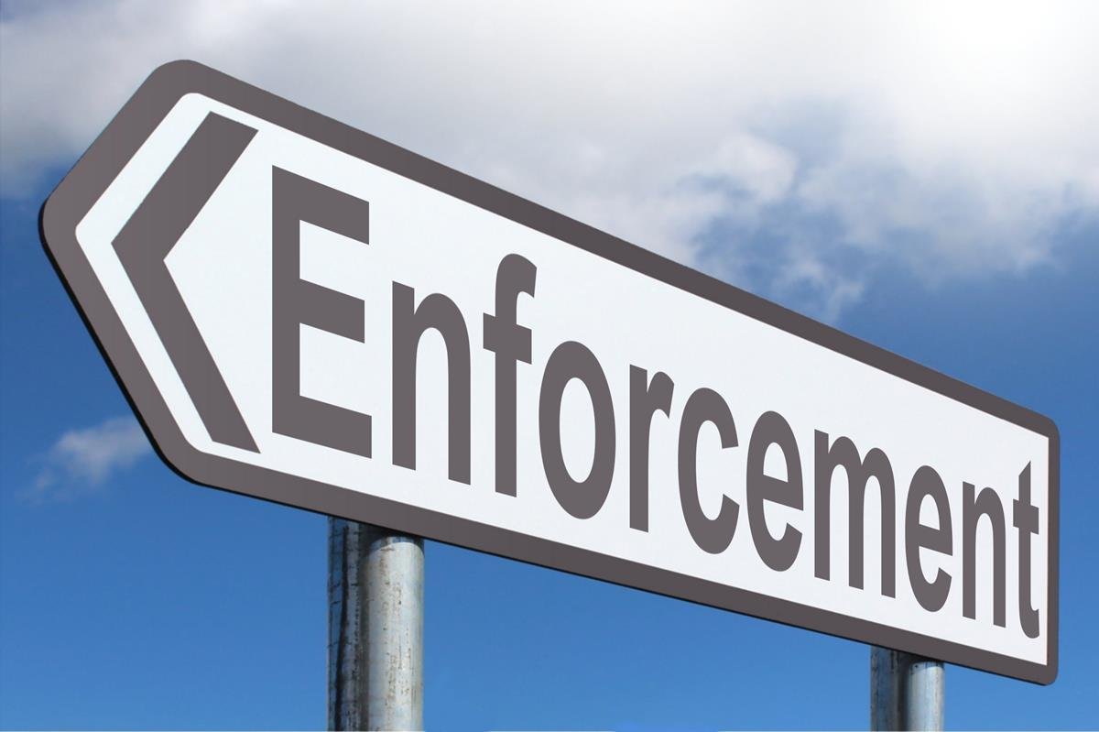
How is that waste still there?
+ Estimated 103,600 t of EPR materials still going to waste
This Photo by Unknown author is licensed under CC BY-SA.

Slide 15
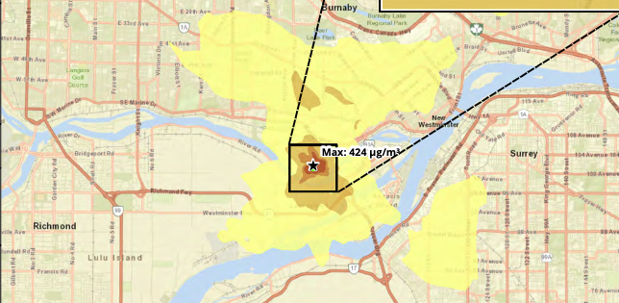
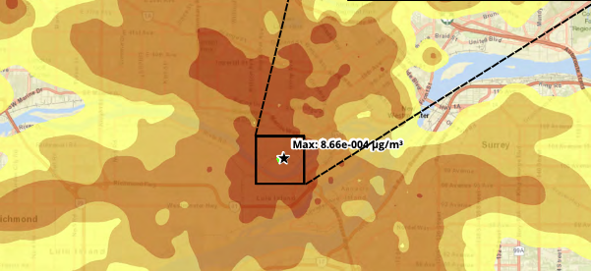
District Energy
Cost rising- from $55M to over $75M
More people will be living closer to the incinerator (River District 6 km)
Risk of relying on waste incineration
District energy should only be based on renewable clean energy sources
Can reduce GHGs more by closing WTE
Notes:
District energy is a great concept, but only when coming from renewable energy sources, not ones that are polluting and should be phased out.
RWDI report graphic source-not to say it is harmful but to show dispersal of key pollutants
July 13, 2023 ZWC package shows about 40,000 t GHG to be reduced by District energy but can reduce by 235,000t if shut down WTE

Slide 16
Risks
Costs -escalating
Regulation -GHG and other environmental
Lock in
Ash –still needs to go somewhere, environmental and safety risks as well as a cost
Opportunity costs -Metro Vancouver’s use of waste incineration has delayed progress on Zero Waste by diverting funds to disposal, has cost the region much more than Zero Waste or even landfilling and has created more GHGs emissions than Zero Waste or even landfills.

Slide 17
Potential savings if shut down incinerator
All future capital costs – shut down costs – transfer station costs + use of land
Operating costs (note contract ends 2025)
Staff time to report on emissions + monitoring costs
No need to try to find places for ash to go
Decreased health and environmental risks
GHG savings
Air quality benefits

Slide 18
Helping Metro Vancouver to meet its goals
Societal improvement
Affordability
Circular economy
Climate change
Environmental stewardship (air emissions, ash disposal, diversion options, upstream)
Notes:
Goals noted in recent consultation for updated plan, closing the incinerator works for all of these

Slide 19
Recommendations
Adopt ZW definition and hierarchy
Shut down WTE
Use savings to work on ZW –especially rethink, reuse, reduce
3Rs Study
Conference findings
NZWC work
Collaboration & partnerships
Enforcement
Use existing LF while waste is decreased
Ensure existing landfills manage methane well

Slide 20
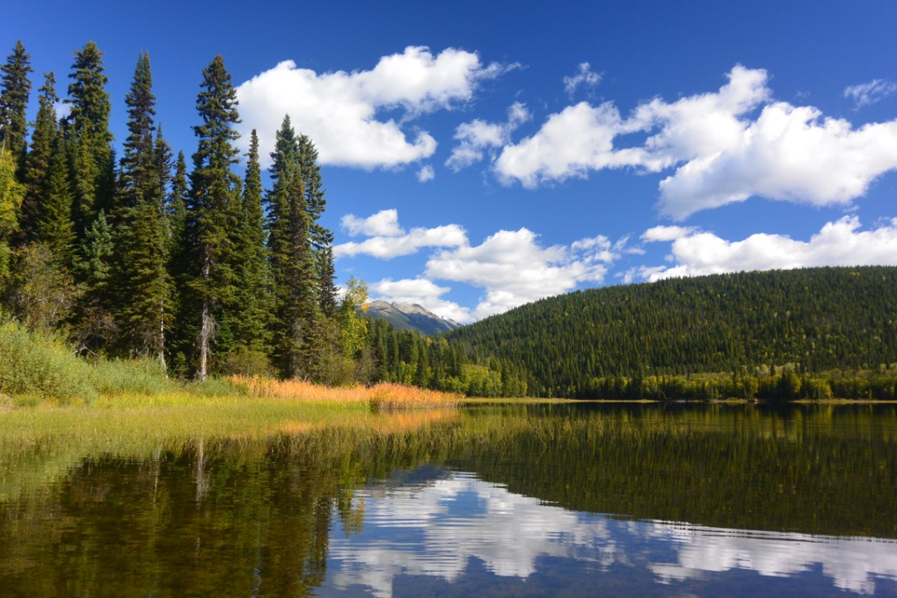
Ths, q contact
Thank you
Sue Maxwell
Zero Waste BC
smaxwell@zerowastebc.ca

