Slide 1

Zero Waste BC
Why Zero Waste is a suitable direction for Kitimat
District of Kitimat –Mayor and Council
August 17, 2020

Slide 2
Zero Waste
The conservation of all resources by means of responsible production, consumption, reuse, and recovery of products, packaging, and materials without burning and with no discharges to land, water, or air that threaten the environment or human health.
2018, Zero Waste International Alliance, www.zwia.org
Notes:
Design principle, target, emulate nature by cycling materials as resources

Slide 3
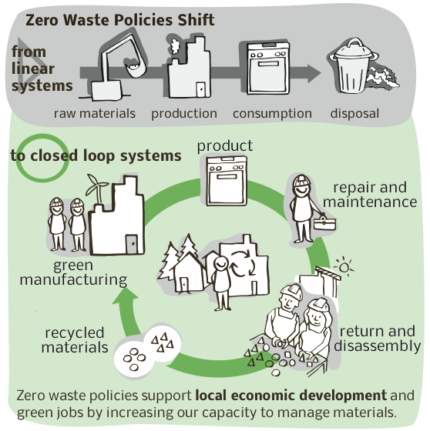
Zero Waste System
Notes:
Graphic Sam Bradd, CCPA

Slide 4
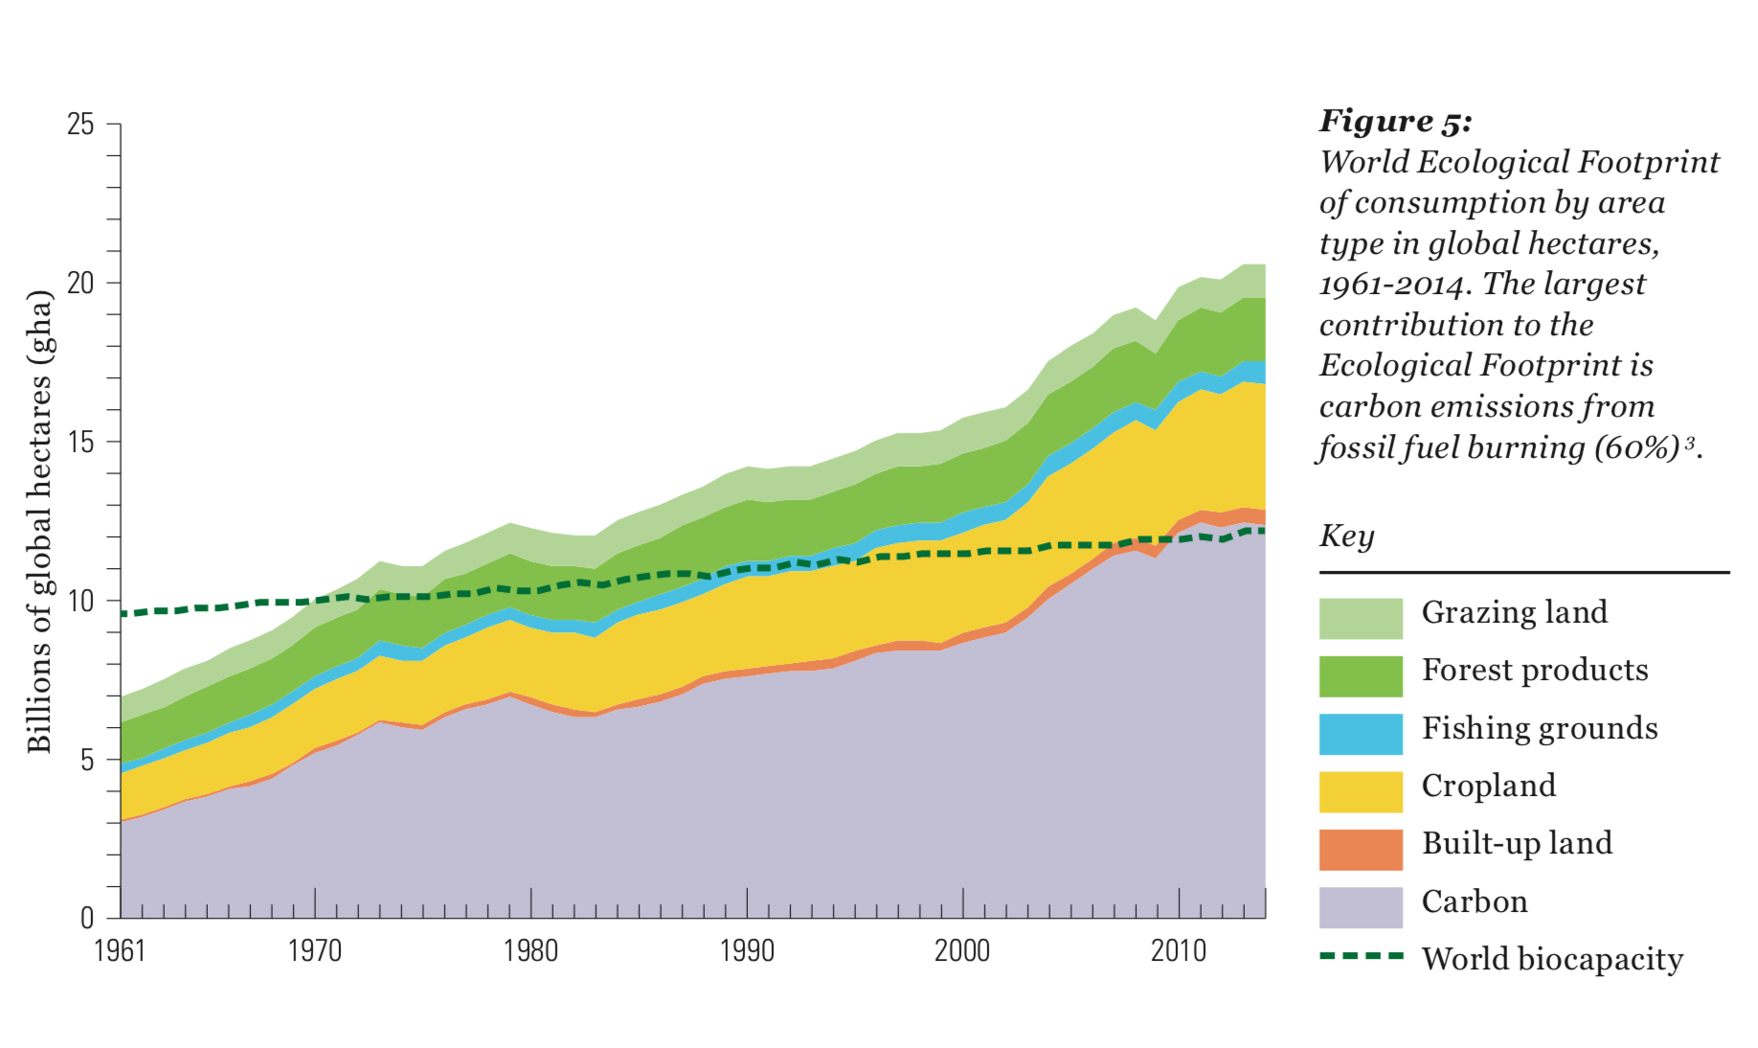
Notes:
More than one planets worth of space to produce resources and absorb wastes. Our current system comes with pollution, habitat and species loss and a host of other impacts.

Slide 5
Waste to Energy
Expensive to build and run
Risk –many kinds are unproven at scale
Still wasting materials (energy components of waste: plastics, paper, organics)
Not a renewable energy
GHG emissions
Pollution –everything that goes in comes out, increasing requirements
Poor solution –worse than landfilling and recycling and composting for human health, environmental health and GHGs
Locks into wasting
Still need landfills
Opportunity costs
Notes:
Energy –Metro Van 2007; WTE LCA –MOE Draft ZW Business Case, 2011 Stante4c Report to BC MOE

Slide 6
Provincial requirements -WTE
Needs an amendment to the regional Solid Waste Management Plan
Must have goal and plan to reach 350 kg waste per capita or less (DoK >740)
WTE is only considered after considering higher levels of the hierarchy and does not impede reduction, reuse or recycling
Must be able to achieve at least 60% energy efficiency (over a year)
Must have a technical assessment comparing options
Must be the best available technology
Must have clear solutions for ash, fly ash, byproducts
Must meet provincial emissions requirements
Notes:
MOECCS Information Sheet Waste to Energy and Solid Waste Management Plans (Nov 2018)

Slide 7
Questions to ask
What are total costs –building, maintaining and meeting new requirements?
Does the waste need to be pretreated or sorted?
What happens to every atom that goes in and where does it go? Where will heavy metals go?
What are the inputs? Water, energy, waste –how much and what kinds
What are the outputs? Gas, liquid, solids, ash,etc. and what is in them
What are the risks –safety, environment, financial, liability?
What regulations apply, what process is needed to meet them and who is responsible for doing that?
Are there working examples of the same systems elsewhere and can you talk to a local government representative (not an industry spokesperson)?
Does there need to be a guaranteed amount of waste?
What else could we accomplish with that amount of spending?

Slide 8
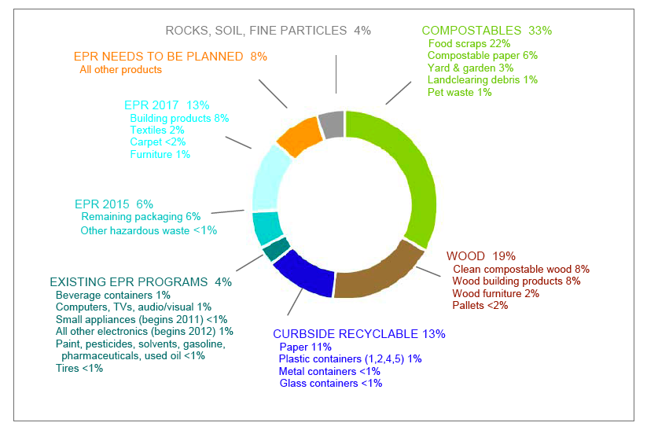
Waste Composition
City of Vancouver

Slide 9
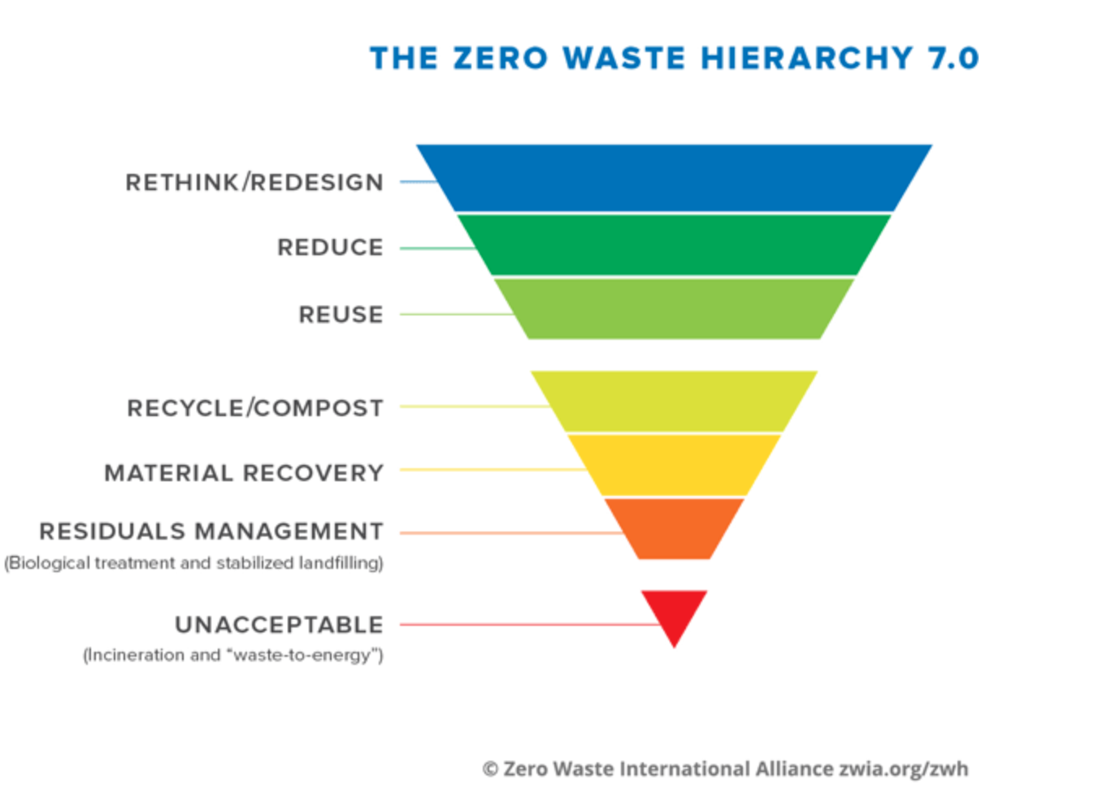
Zero Waste Opportunities
Single Use Items
Curbside residential recycling
Organics collection and composting
Extended Producer Responsibility Programs
Provincial and Federal Plastics Initiatives
Climate Caucus –Zero Waste tools for local government
KUTE and working with community
Landfill space –an opportunity

Slide 10
Thank you
Sue Maxwell
Zero Waste BC
susanmaxwell@shaw.ca

